Slide 1

Marketing Analysis Challenge
Chudi Egbebike

Slide 2
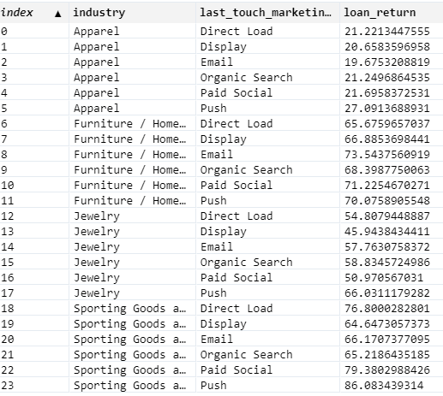
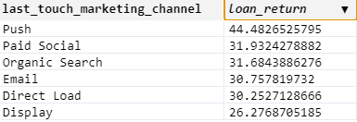


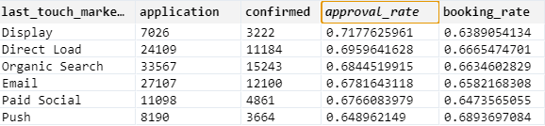
Marketing Channel Analysis
Because company X prioritizes signing merchants and driving profitable loan volume, I calculated both the marketing channels that returned the most profits as well as the most effective marketing channels (highest yield) given each industry
Based on this information I would invest more time and energy into optimizing push marketing engagements due to the fact that within each industry (except Furniture) it is the highest profit producing marketing medium. The push channel has the 2nd lowest application total (8190) and the worst approval rate, yet it touts the highest booking rate at 0.69 and the highest loan return by far

Slide 3
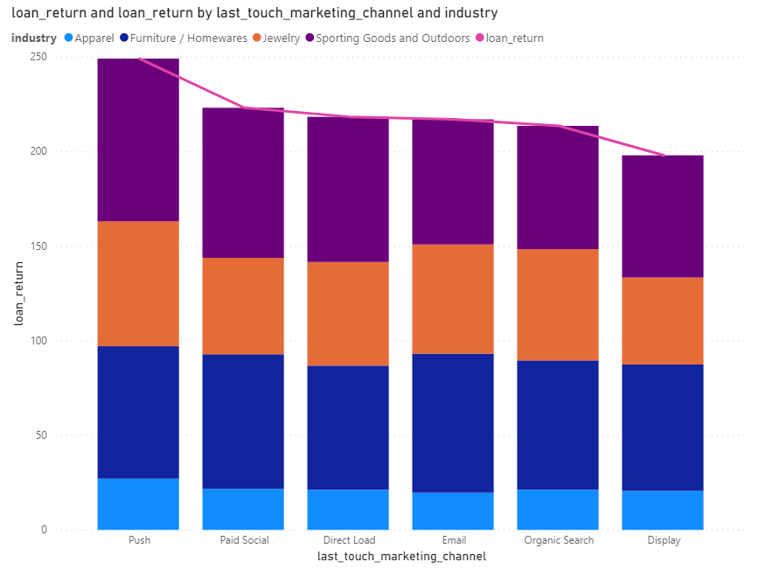

Slide 4

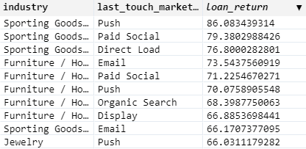

Industry Analysis
The Sporting Goods Sector averaged the highest profit returns ($97.8) while simultaneously averaging both the lowest application total (10,145, roughly ~9% of Apparel’s total) as well as the lowest booking rate. This leads me to believe that a greater marketing emphasis should be placed targeting this sector. A concerted email marketing campaign that was targeted to users in this industry would likely see lucrative results

Slide 5
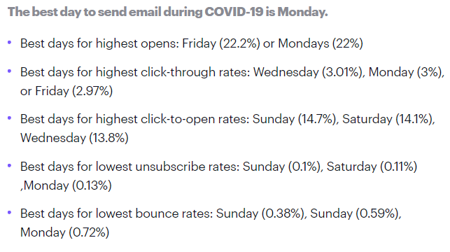
A/B Testing for Email Campaign
Best day to send email during Covid:
Business Value:
Great for testing changes that directly impact customer behavior
Increase sales within a mobile application
Can provide statistical summaries such as confidence intervals
Increase user interactions with website
Key Metrics:
Open rate
Opens / Delivered Emails
CTR (subject lines)
Clicks / Delivered Emails
Click to open rate
Clicks / Open
Unsubscribe rate
Unsubs / Opens or Unsubs / Delivered
https://www.campaignmonitor.com/resources/guides/covid-19-email-benchmarks/#three

Slide 6
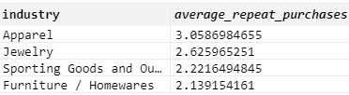
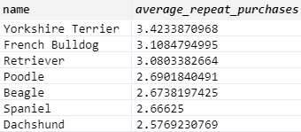
Repeat Purchase Rate
According to the data the repeat purchase rate for all users was 19.74%
The top 2 industries that averaged the highest number of repeating purchases was Apparel and Jewelry (at 3.06 and 2.63 respectively)
Comparatively the top merchant that averaged the highest number of repeating purchases was Yorkshire Terrier. The data shows that positive repeat purchase rate doesn’t correlate with high profit yield.
#Calculating repeat purchase rate
Repeat_customer = merchant_performance_rates.groupby(‘user_id’).confirmed.sum()
Total_purchasers =
repeat_customer.loc[repeat_customer > 0]
Repeat_purchasers =
total_purchasers.loc[total_purchasers > 1]
Repeat_purchase_rate = repeat_purchasers.count()/total_purchasers.coun()

Slide 7
Appendix
After exploring the data, what additional data what you need to create actionable insights:
In order to attract users with more success and minimize churn rate, it would help to understand demographics associated with users. With this information we can ask:
Why is it that ____ has the highest churn rate amongst 20-25 year olds?
Nuanced analytics such as psychographics can then be applied if the management team is of the belief that behavior propagates throughout the entire supply chain. Data points such as these can then be funneled into optimized forecasting models.
Instead of ranking users based on churn likelihood, you can also rank them in priority of when they’re most likely to churn. Having this sort of knowledge helps the marketing department lessen the probability of a churn by communicating new or existing promotions that may be user-specific (contextualized by each user’s unique profile)
Another other question I’d want to ask is: what devices are linked to the multiple marketing channels? Which devices are the most effective for each medium and why? I could use this data to see if the system of crediting touchpoints is in fact the most optimal system. Splitting marketing channel credit (i.e. forgoing last interaction attribution model) might require more work, but it can very well lead to direct profit increases in both the short and long term

Slide 8
Appendix (cont)
Time Series Cohort Analysis
Given time series data we could do a cohort analyses and track behavior over time such as repeat purchase rate or customer retention (% of active users over total customers) and visualize on a heatmap
Can use dates from a wider time period to determine purchasing seasonality (i.e weekly trend that might suggest users did most of their purchasing on the weekend)
Seasonality can hide larger trends so we can correct seasonality by calculating a trailing average
Trailing average sets the value for a given day as the average over the past N days (for a weekly training average, N=7 trailing
Can also use dates to apply exponential moving averages so that the more recent purchases are weighted heavier to determine macro trends.
We can create a profile of users and marketing channels that converted fastest
average..
Trailing average sets the value for a given day as the average over the past N days (weekly N=7)

